Slide 1

High speed automatic scanning systems
(past, present and future R&D in Italian labs)
Valeri Tioukov (INFN, Napoli)

Slide 2
Emulsion activities in Napoli lab
OPERA analysis – is the main task now (for another year at least)
Muon Radiography: Unzen, Stromboli, Teide exposures – see my afternoon talk
Medical Physics: Carbon fragmentation study, proton beam study (see Adele Lauria talk on Friday)
Directional dark matter search R&D in the collaboration with Nagoya group
Fast Scanning Systems R&D (this presentation)
High precision Scanning System R&D

Slide 3
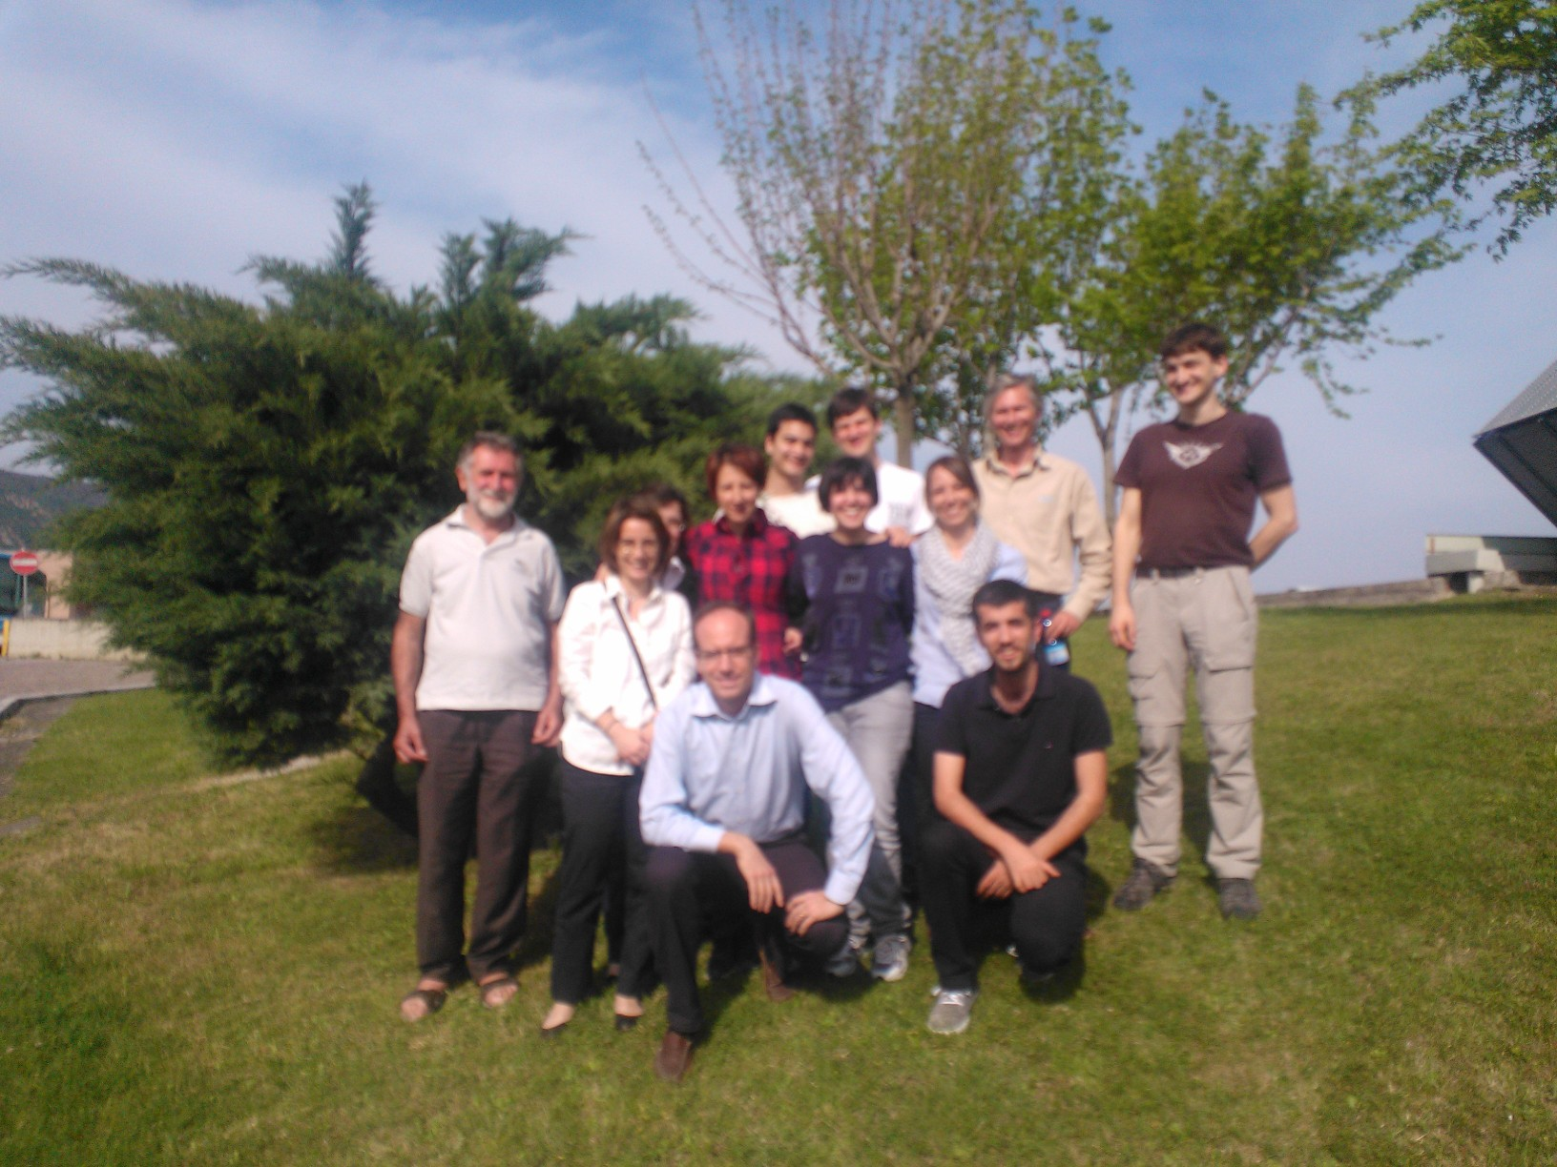

Slide 4
Toward the automatic emulsion analysis
Before 1974 – the only way to find the
charged particle tracks and decays in
the nuclear emulsions was the eye
inspection using manual microscopes
1974 K. Niwa: Track recognition by
superimposing tomographic images from different focal planes
This was the first idea of the automatic
scanning but the digital technology was not ready yet in that time
(the first Digital Camera prototype -1975)
1980 – First semi-automatic scanning (Nagoya)
1985 – “Track Selector” (TS) the first automatic scanning system based on tomographic image processing. Started TS-NTS-UTS-SUTS development line (Nagoya)
1994 – CHORUS data analysis – Napoli group enter into scanning business: 2 microscopes equipped with NTS systems arrive to Naples
2004 – the first prototype of the European Scanning System dedicated for OPERA scanning operational in Naples, developed in collaboration with other Italian groups

Slide 5
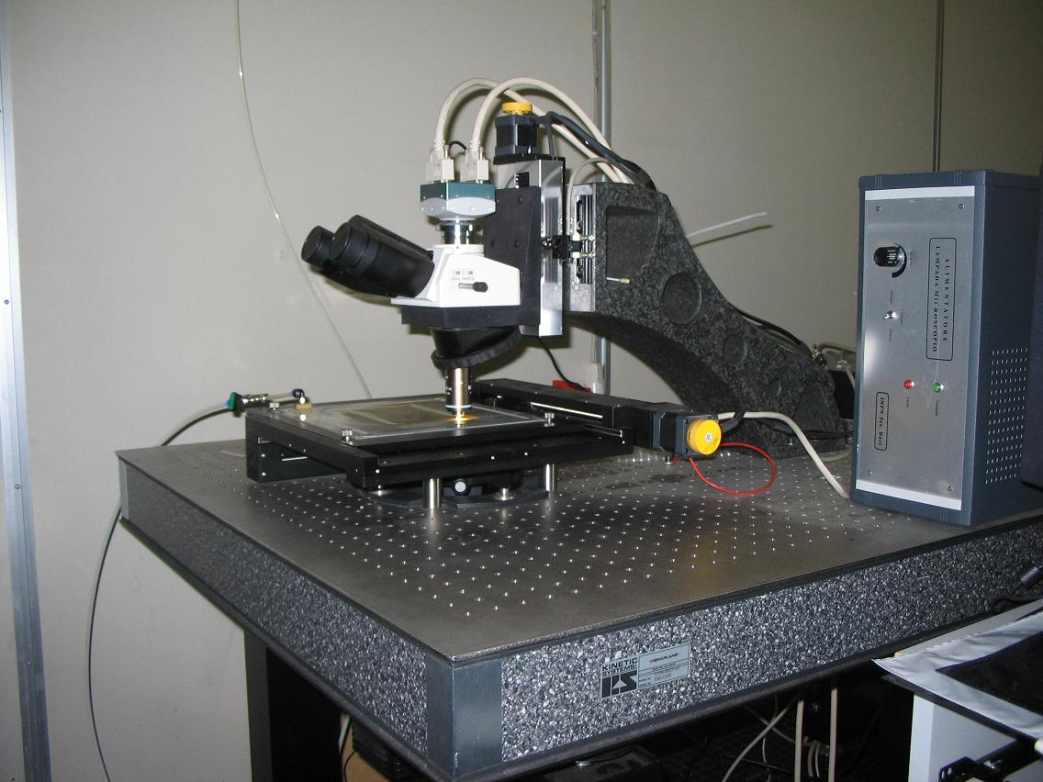
Closer view to the ESS
Z stage (Micos)
0.05 μm nominal
precision
CMOS camera
1280×1024 pixel
256 gray levels
376 frames/sec
(Mikrotron MC1310)
Emulsion Plate
XY stage (Micos)
0.1 μm nominal
precision
Illumination system, objective (Oil 50× NA 0.85)
and optical tube (Nikon)

Slide 6
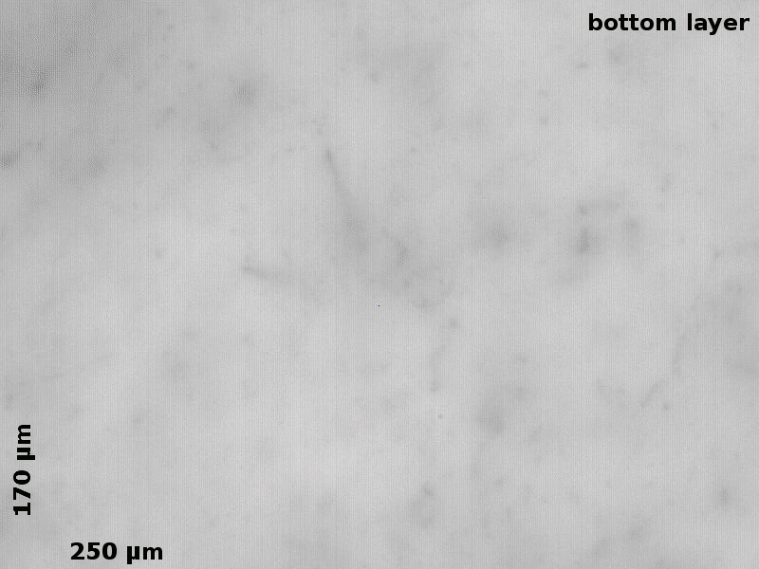
What the microscope CCD sees in one film..

Slide 7
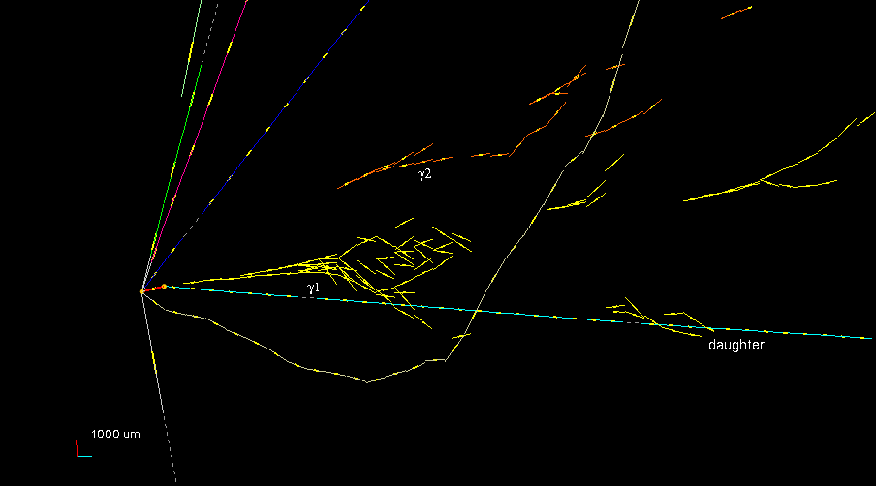

Slide 8
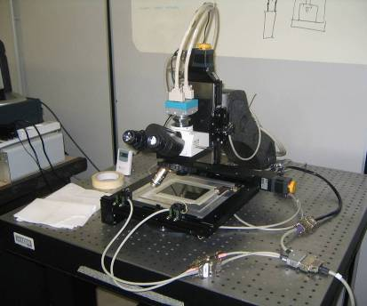
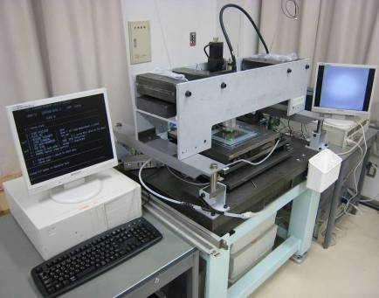
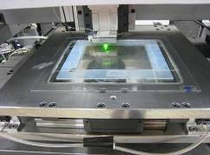
EU: ESS (European Scanning System)
Japan: SUTS (Super Ultra Track Selector)
• Scanning speed/system: 20 cm²/h
• Customized commercial optics
and mechanics
• Asynchronous DAQ software
Relatively cheap and easy to clone
• Scanning speed/system: > 75 cm²/h
• High speed CCD camera (3 kHz),
Piezo-controlled objective lens
• FPGA hard-coded algorithms => GPU
Expansive system based on home-made
Image processing electronics
Both systems demonstrate:
• ~0.3 μm spatial resolution
• ~2 mrad angular resolution
• ~95% base track detection efficiency

Slide 9
Scanning laboratories equipped with European Scanning Systems (ESS)
Napoli: 6 microscopes (5 OPERA & 1 R&D)
Salerno: 4 (3&1)
Bologna+Padova: 5
Bari: 4
Frascati: 2
LNGS: 10 dedicated to OPERA CS scanning
Bern: 6
Russia: 4
Tokyo: 2
Total scanning power in Italy is equivalent to 31 ESS

Slide 10
Evolution of the European Scanning System
Why new R&D?
  The project is based on 10 years old components, some of them went out of production
  New requirement for a fast scanning of a large surfaces (as muon radiography) or large angles (as medical applications)
  New ideas for improving the performance
Two (complimentary) lines of Italian R&D
  Based mainly on the software and algorithmic improvements (LASSO)
  Based mainly on the HW improvements (QSS)

Slide 11
LASSO development history
2011: ESS limits study as a part of upgrade R&D
2011: Idea of the continuous scan: possibility to double the scanning speed without additional HW investment
2012: New 3-d grains-based tracking is developed for the Continuous Motion scan
2012: fine image corrections and merging study
2012: First tests of a new tracking at the big angle using S&G data
presented the Large Angle TB data analysis in Stop&Go mode
2013 all wide area and large angle scanning in Napoli lab we perform with LASSO in S&G mode
2013: Final tests and start production with the Continuous Motion mode scanning

Slide 12
Hardware Limits Summary
Calculated for the standard ESS optics
VT, AA 04/2011 It
Standard hardware
Camera | 376 fps, If every frame is used | < 100 cm²/h
Stage-Z | 50 µm cyclic motion, camera @ 376 fps | < 53 cm²/h
Odyssey | 16 images/view, camera @ 376 fps, byte image transfer | < 50 cm²/h
Odyssey and the stage defines the theoretical limit to the scanning speed of 50 cm²/h with the existing HW
Scanning with the speed > 20 cm²/h should be possible even with the existing hardware

Slide 13
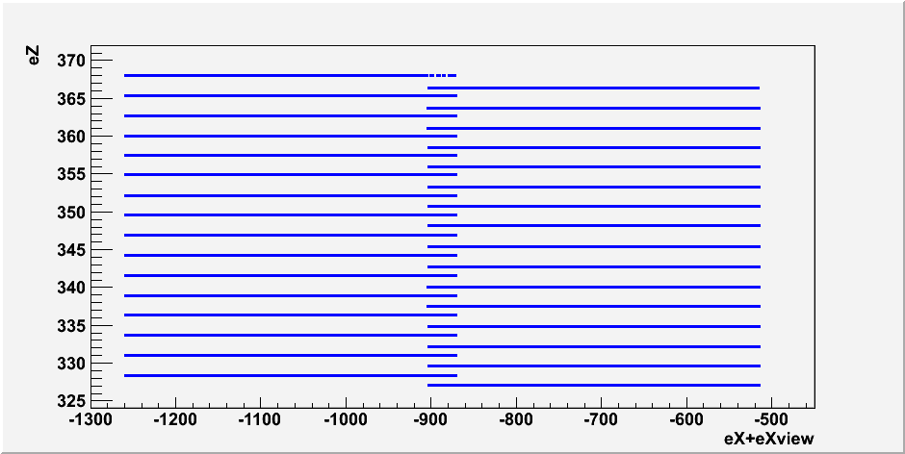
Standard ‘Stop&Go’ Motion
55 ms
data acquisition
+
95 ms
back motion
=
150 ms
duty cycle
Data acquisition is performed in movement along Z axis while X and Y axes are in rest
For thin emulsions and large field of view movement to the next view can become a speed-limiting factor
The ESS scanning speed is limited to 20-25 cm²/h
(with standard HW)

Slide 14
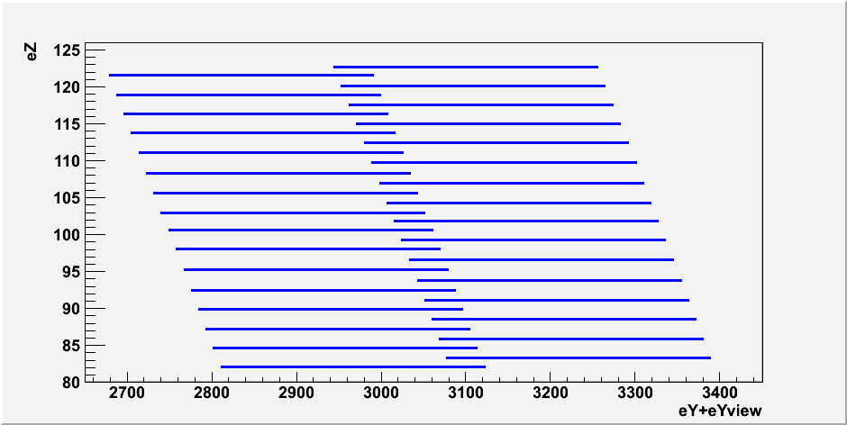
Continuous Motion
Constant-speed motion along Y-axis
55 ms
data acquisition
+
25 ms
back motion
=
80 ms
duty cycle
Continuous cyclic motion in Z (80-90 ms/view)
Continuous constant speed motion in Y (speed = 280 microns/80 ms = 3500 micron/s)
Serpentine-like path in a horizontal plane
horisontal shift of consecutive frames is of 9 µm
The ESS scanning speed increases to 40-45 cm²/h without any hardware modification

Slide 15
Importance of the view deformation corrections in case of CM
VT, AA 07/2011 It
There are many effects (summary is on the next slide) leading to the image deformations so that the accuracy of our knowledge of the real grain position depends on it’s location inside the microscope view. The overall effect is normally is of the order of one micron.
Usually we neglect this effects because in the standard scan the images pile in the View is vertical (no XY movement while data taking) and in practice all these effects leads mainly just to the microtracks angle deviation depending on it’s position inside the view. These deviations are usually inside the accepted measurement errors.
But them can not be ignored in case of the continuous motion:
The straight tracks leave
curved path due to image
deformations
45 µm
300 µm

Slide 16
Summary of the main deformation effects
VT, AA 07/2011 It
XY 2-dimensional effects:
  Matrix (camera) rotation in respect to the stage
  Pixel to micron ratio error
  2-d image distortion (pixel/micron is not uniform inside the view!)
  Optical axes (one or more) are not parallel and/or not centered
XYZ 3-dimensional effects:
  Specimen focal plane curvature
  Focal plane inclination
Off-axis grains inclination

Slide 17
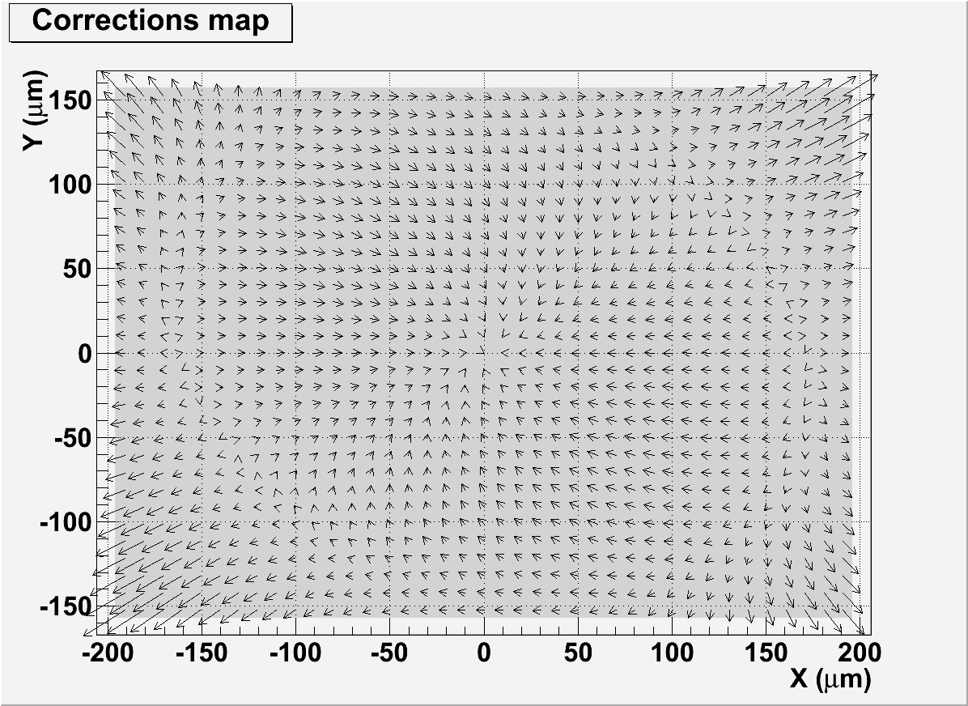
Corrections up to 1.5 µm near the view angles

Slide 18
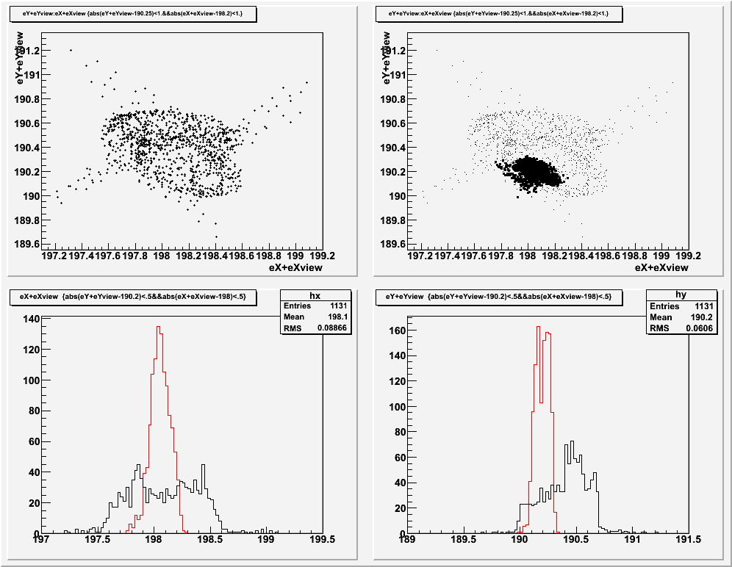
Accuracy before and after correction
VT, AA 07/2011 It
Before correction
The single
grain was
observed 1131
times in a views
shifted 10 µm
After correction
(bold dots)
After application
of the correction
matrix the
spread reduced
2-3 times
X-width:
1.1->0.5µm
Y-width:
0.8->0.3µm

Slide 19
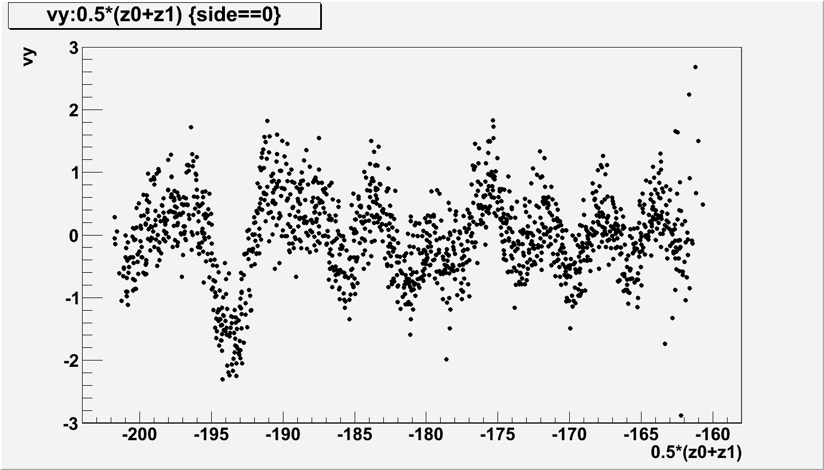
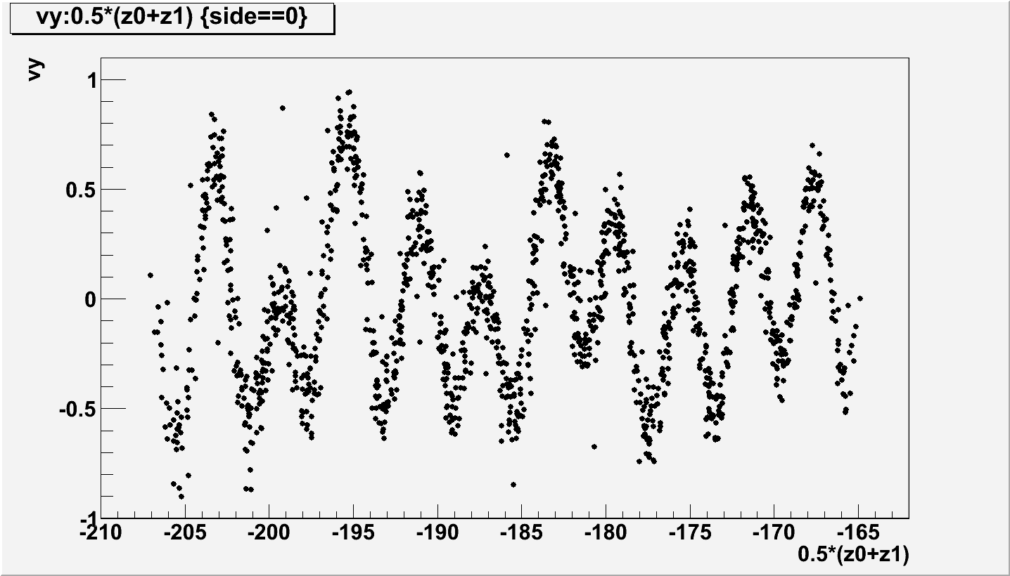
VT, AA 05/2011 It
Vibrations correction using grains shadows
Cont
SnG

Slide 20
Microtracker Processing Chain
Overview
Clusters
(set of pixels, 2D)
Grains Finder
Microtracks reconstruction in case of Continous Motion has many complicate aspects in respect to S&G case.
To handle this task the new dedicated tracker was developed
Grains
(chain of clusters, 3D)
Linker
Links
(pair of grains, 3D+2 slopes)
MT Finder
Microtracks
(set of grains, 3D+2 slopes+puls)

Slide 21
Microtracker Processing Chain
Clusters
(set of pixels, 2D)
Grains Finder
Creates 3D objects, grains, required for an efficient large angle scanning
Searches for (almost) vertical chains of clusters
If a cluster chain is too long to represent a grain then the chain is split into several grains
Reduces the number of objects to be processed by the factor of 2
Grains Finder
Grains
(chain of clusters, 3D)
Linker
Links
(pair of grains, 3D+2 slopes)
MT Finder
Microtracks
(set of grains, 3D+2 slopes+puls)

Slide 22
Microtracker Processing Chain
Grains Linker
Creates objects that possess directional information, links, by connecting two grains within the specified radius
Two strategies were implemented:
  Blind linker (CPU optimized):
    Simple, reliable and relatively fast
    Unpractical at large link length scale since number of links grows rapidly
    Ineffective with poor tracks (few grains, large gaps between grains)
  Total linker (GPU optimized):
    Calculates number of grains along the link and performs density cut
    Should be more effective due to its far-reach (especially with poor tracks)
    Ineffective at short link length scale due to large density fluctuations
Clusters
(set of pixels, 2D)
Grains Finder
Grains
(chain of clusters, 3D)
Grains Linker
Links
(pair of grains, 3D+2 slopes)
MT Finder
Microtracks
(set of grains, 3D+2 slopes+puls)

Slide 23
Microtracker Processing Chain
Clusters
(set of pixels, 2D)
Microtracks Finder
Locates linear grain density anomalies (grain density increase along a particle’s track) in 3D-space by performing a 4D-histogramming of links
In order to improve efficiency at large angles 4D-historgamming is performed in two steps:
  2D-hist in the angular space (φ,θ)
  2D-hist in the coordinate space projected onto plane normal to the selected slope
All slope calculations are performed in (φ,θ)-space (not using tx-ty)
All slope and spatial acceptances and thresholds depend on θ and are calculated in accordance with the grain model used
Performs calculation of track parameters (position, slopes, puls, χ², etc)
Grains Finder
Grains
(chain of clusters, 3D)
Grains Linker
Links
(pair of grains, 3D+2 slopes)
MT Finder
Microtracks
(set of grains, 3D+2 slopes+puls+ χ²)
No internal angular limits: horizontal tracks can be reconstructed as well as vertical ones

Slide 24
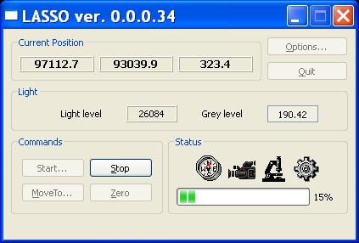
LASSO Structure
(Standard HW)
GUI Module
Image Processing Module
PAVProcModule.dll
nVidia
GTX 690
Board
Clusterizer
Library
OpBTProc.dll
Guide Module
PAVGuide.dll
Matrox
Odyssey XPro Board
Tracker Module
OpTraProc.dll
Stage Module
PAVStageModule.dll
Camera Module
PAVCameraModule.dll
Stage Adapter
FlexStage.dll
Camera Adapter
ONLCamera.dll
MICOS
MS-8
Stage
NI Motion
PCI-7344 Board
MICOS
LS-110 Stage
Mikrotron MC-1310 Camera
HDD

Slide 25
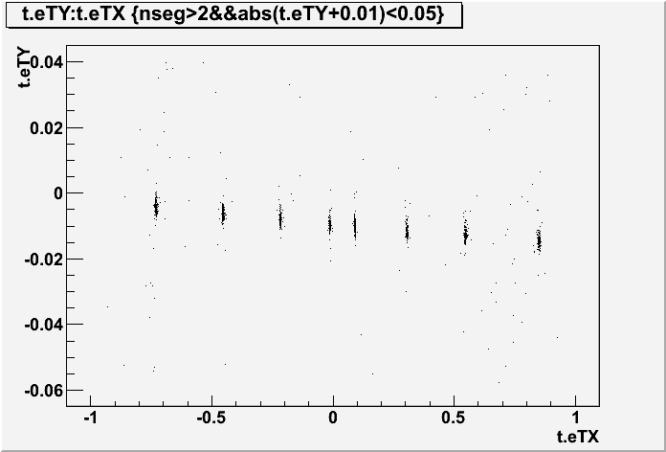
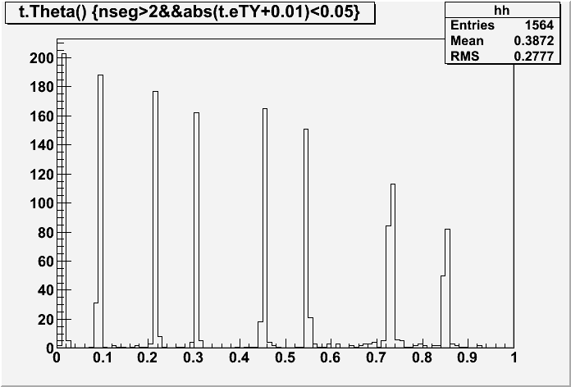
Pions test beam (2007) data
The data from the CERN pions
test-beam of 6-7 years ago
typically used for this kind of
test. Emulsions are little bit yellow-green, but still usable.
8 plates without lead
8 peaks covers range up to slope = 0.85

Slide 26
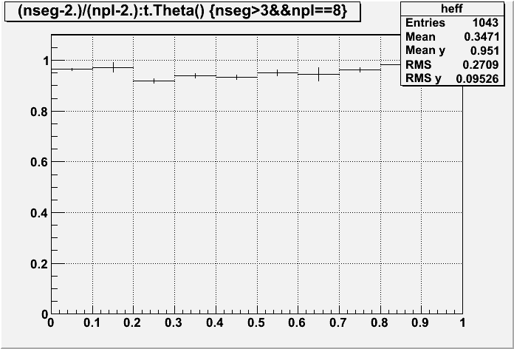
Effect of the resent improvements on the basetracks efficiency
(2007 test beam data, S&G mode scan)

Slide 27
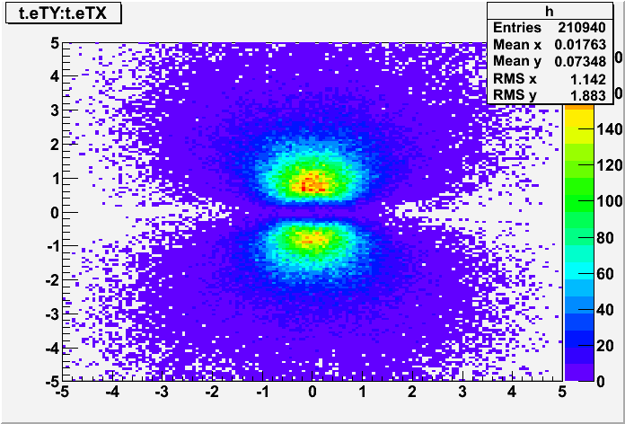
Nagoya Tau plates reconstructed in the transportation order
All scanned plates we aligned in the transportation order: with Zgap = 300 microns
Long passing throw transportation tracks were used for efficiency estimation
Angular acceptance in this test is up to tan = 5.5
1 radian

Slide 28
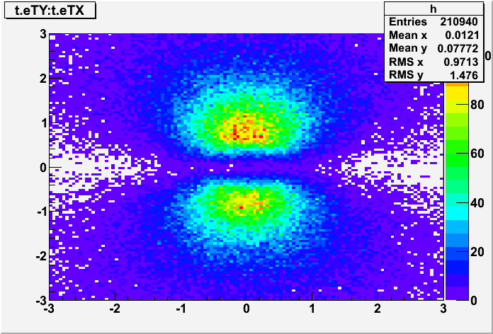
Nagoya Tau plates reconstructed in the transportation order
All scanned plates we aligned in the transportation order: with Zgap = 300 microns
Long passing throw transportation tracks were used for efficiency estimation
Angular acceptance in this test is up to tan = 5
1 radian
Zoom of
the
central
region

Slide 29
Microtracks likelihood study
Score = Log((N_{grain}/N_{mip})*(N_{eff}/N_{mip})*(L_{track}/L_{view})*(L_{track}/MaxGap))
N_{grain} – found grains number using splitting
N_{mip} – expected for mip grains number
N_{eff v} – grains number estimated using microtrack volume
L_{track} – microtrack length from first to the last grain
L_{view} – maximal possible microtrack path in this view
MaxGap – biggest gap inside microtrack

Slide 30
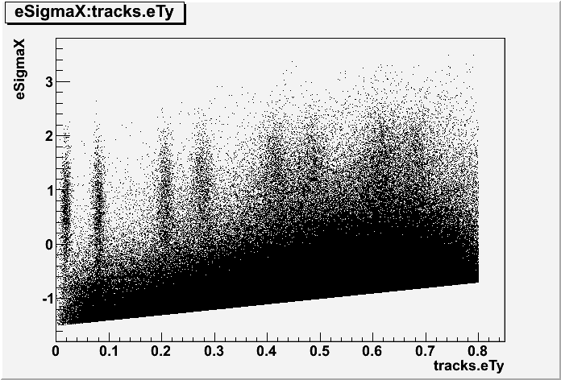
Score vs Theta
Score
Theta
Score = Log((N_{grain}/N_{mip})*(N_{eff}/N_{mip})*(L_{track}/L_{view})*(L_{track}/MaxGap))

Slide 31
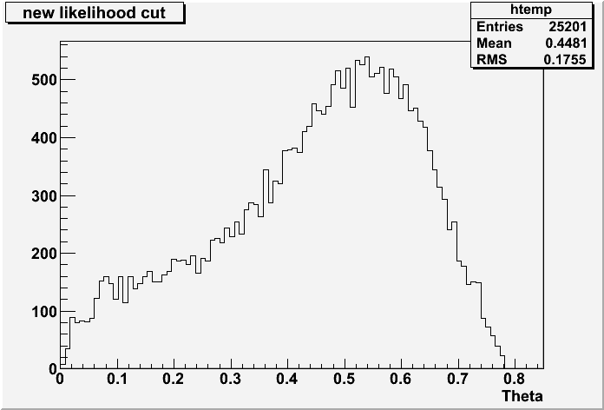
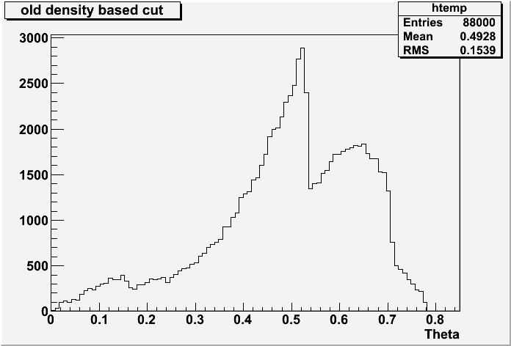
new
(likelyhood based)
selection
Effect of the new cut
3-4 times less mt/view
Same efficiency
Smooth distribution
Old
(grains density based)
selection
Theta

Slide 32
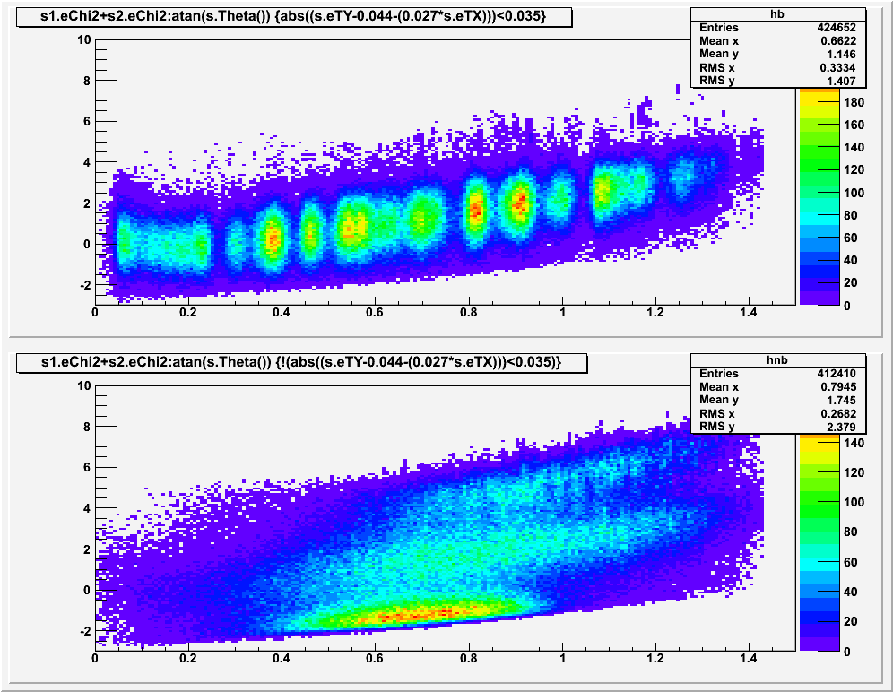
Effect of the likelihood selection on the basetracks
Large angle test beam data were used
Score
Beam region
Out of beam (Cosmics) region
Score
Theta

Slide 33
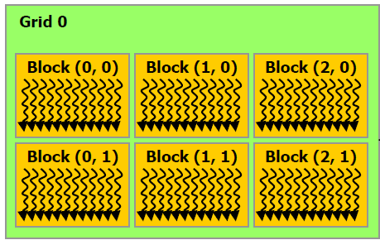
Processing on GPU: image
Modern graphics processors have thousands of arithmetic logic units, which can be used for general purpose computation.
Image processing is ideal for GPU.
Whole image processing cycle in LASSO was implemented in CUDA:
Lightfield normalization
Filtration (5x5 FIR)
Applying threshold map
Field equalization
Binarization
Great performance gain was obtained in comparison to processing on Matrox Odyssey board, where processing was done before:
Model | Time ms/frame
MATROX Odyssey Xpro
OP310G5MSFCL | 6.6
OP413G1GSFCL | 5.4
NVidia GForce
GTX 570 | 0.65

Slide 34
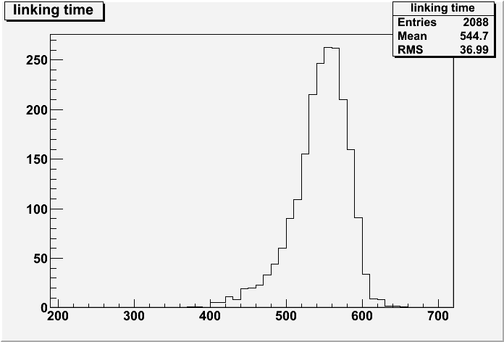
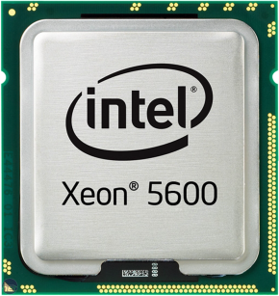
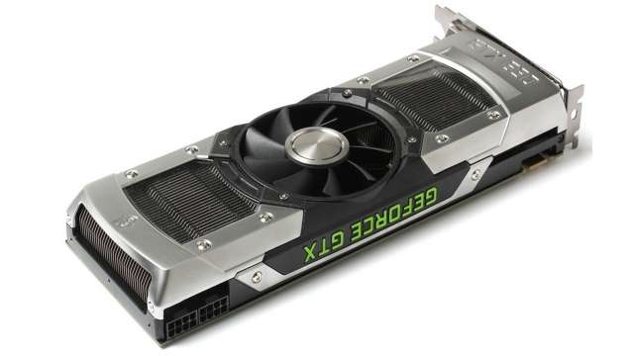
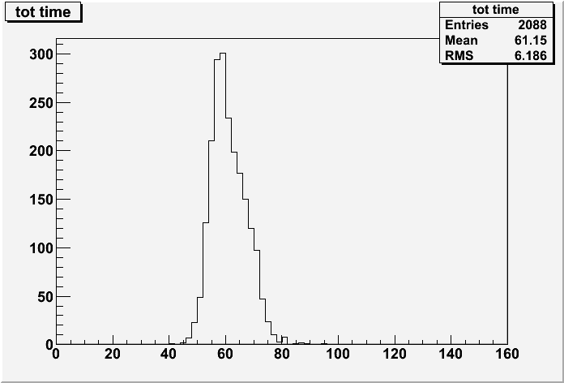
Processing on GPU: Tracking
Tracking procedure consists of few steps. One of them (“Linking”) is the most computation power consumptive. It was also implement it in CUDA.
Dell T7500, Xeon X5650 2.66 GHz, 6 cores * 2 CPU *HT = 24 logical processors
CPU
~550 ms/view
GPU
NVIDIA GTX 690
61 ms/view

Slide 35
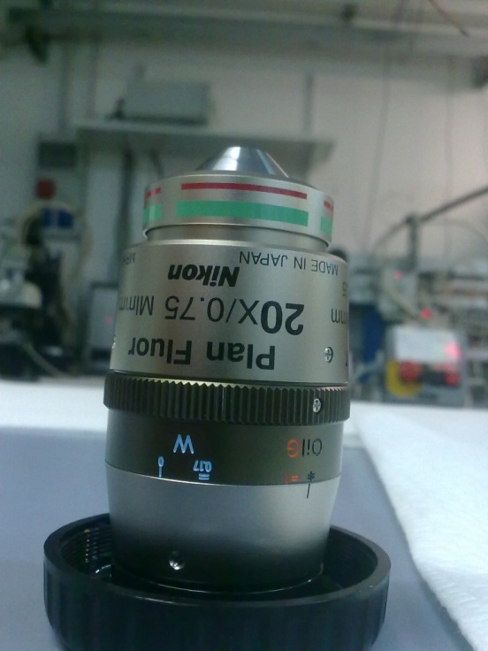
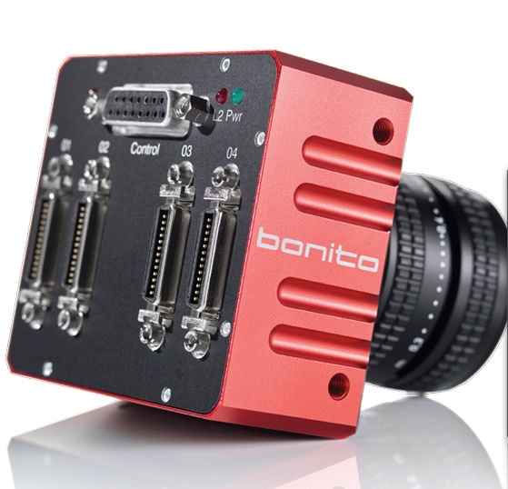
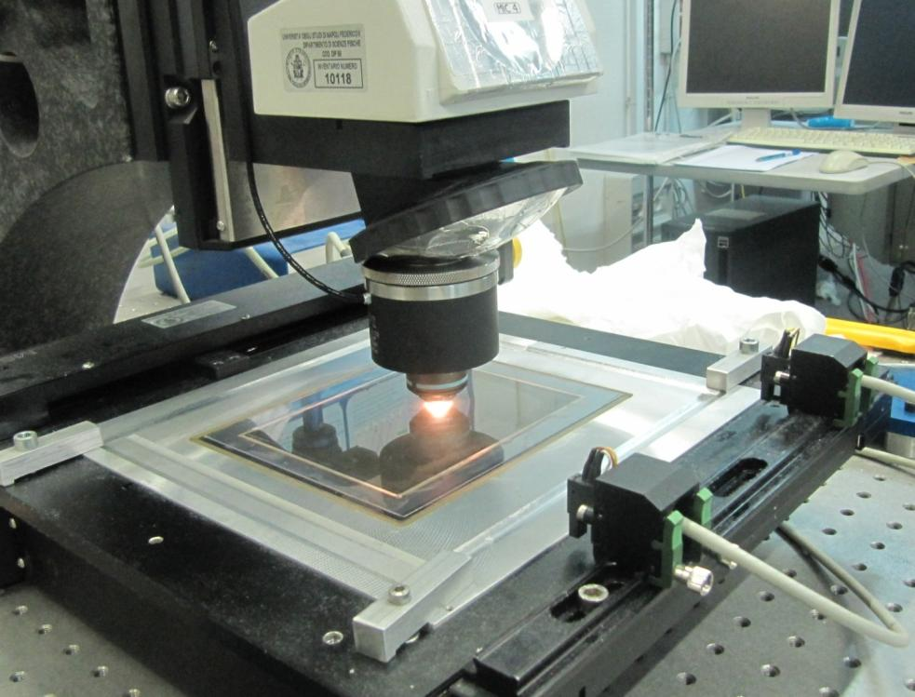
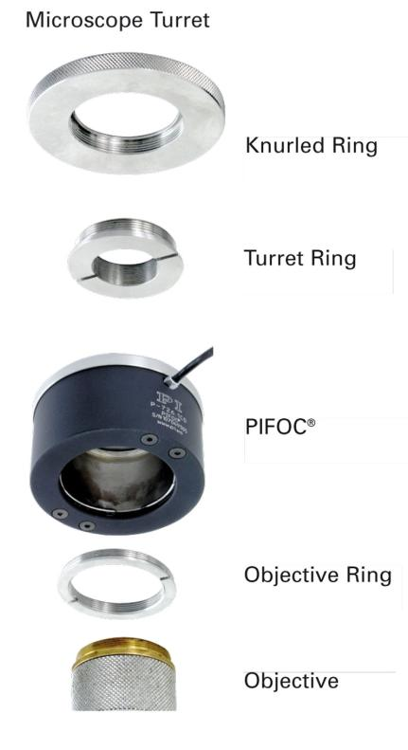
ESS HW Upgrade for the fast scan
Passing to new 4Mpix Bonito CMC 4000 camera and 20x objective will allow to triple the field of view area keeping the pixel size at the same value which will allow to use already existing image processing modules.
PIFOC Pi-726 piezo-drive was successfully tested with 57 ms/view duty cycle which is already 40% faster than the LS-110 stage. Duty cycle time reduction to ~50 ms/view is foreseen possible. The resulting gain in speed will be 50-60% compared to the LS-110 stage
The overall gain of migrating to the new hardware is estimated to be ~4 times or about 150 cm²/h for OPERA-like emulsion films

Slide 36
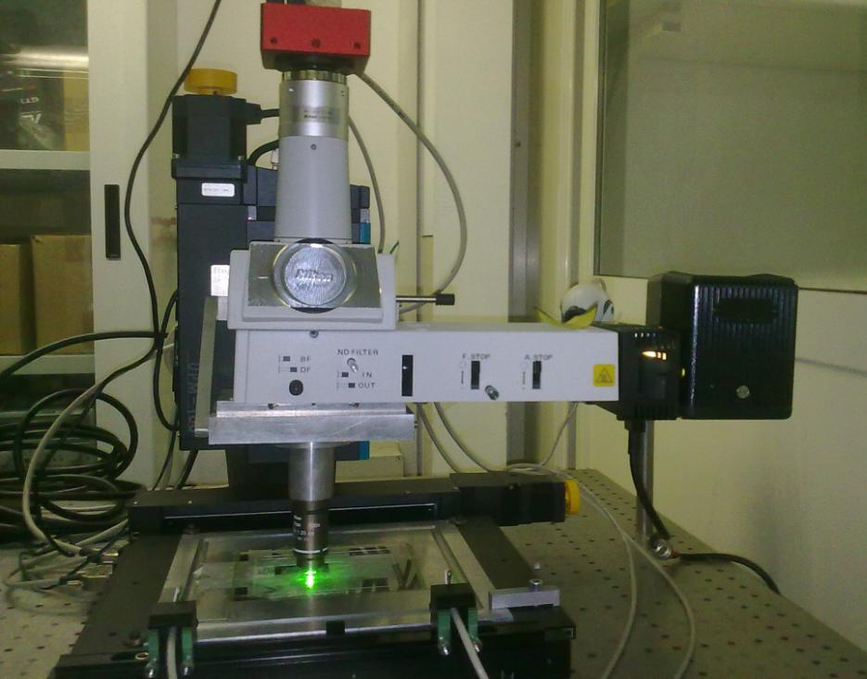
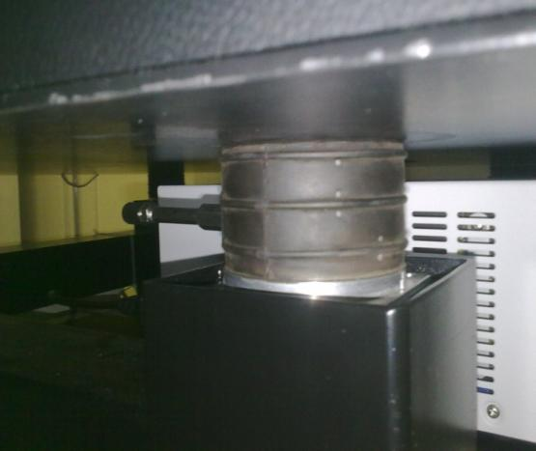
High resolution R&D for the directional DM search
Bonito CL/CMC-4000
CMOS Camera
4 Mpix, @100 fps
Resolution: 28 nm/pixel
View Size: 65.2 x 48.3 µm
Pneumatic Vibration Dumper
100W
Halogen
Lamp
Nikon Oil Objective
100x, 1.25 N.A., Plan
Green Optical Filter
Directional Detection of Dark Matter with Nuclear Emulsion
19

Slide 37
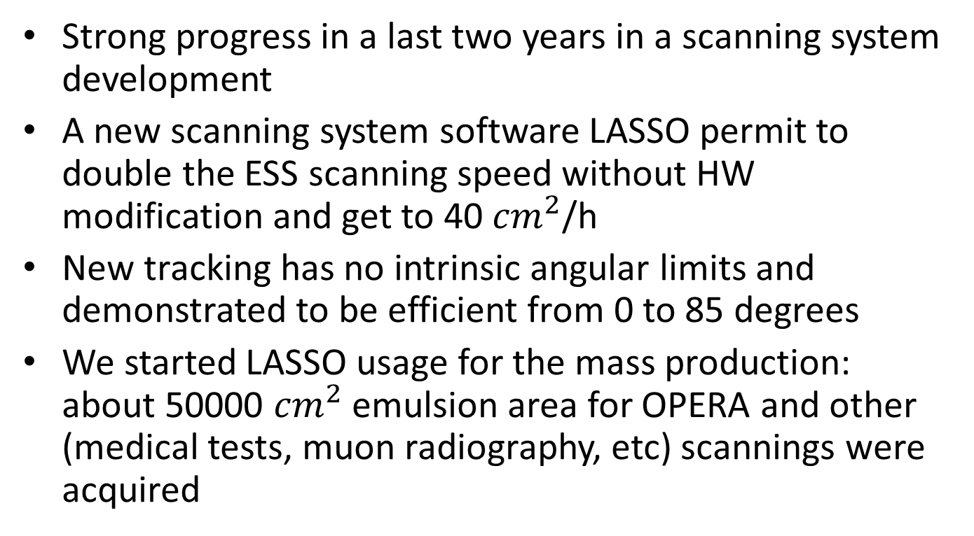
Conclusion
Strong progress in a last two years in a scanning system development
A new scanning system software LASSO permit to double the ESS scanning speed without HW modification and get to 40 ${cm}^{2}$/h
New tracking has no intrinsic angular limits and demonstrated to be efficient from 0 to 85 degrees
We started LASSO usage for the mass production: about 50000 ${cm}^{2}$ emulsion area for OPERA and other (medical tests, muon radiography, etc) scannings were acquired

Slide 38
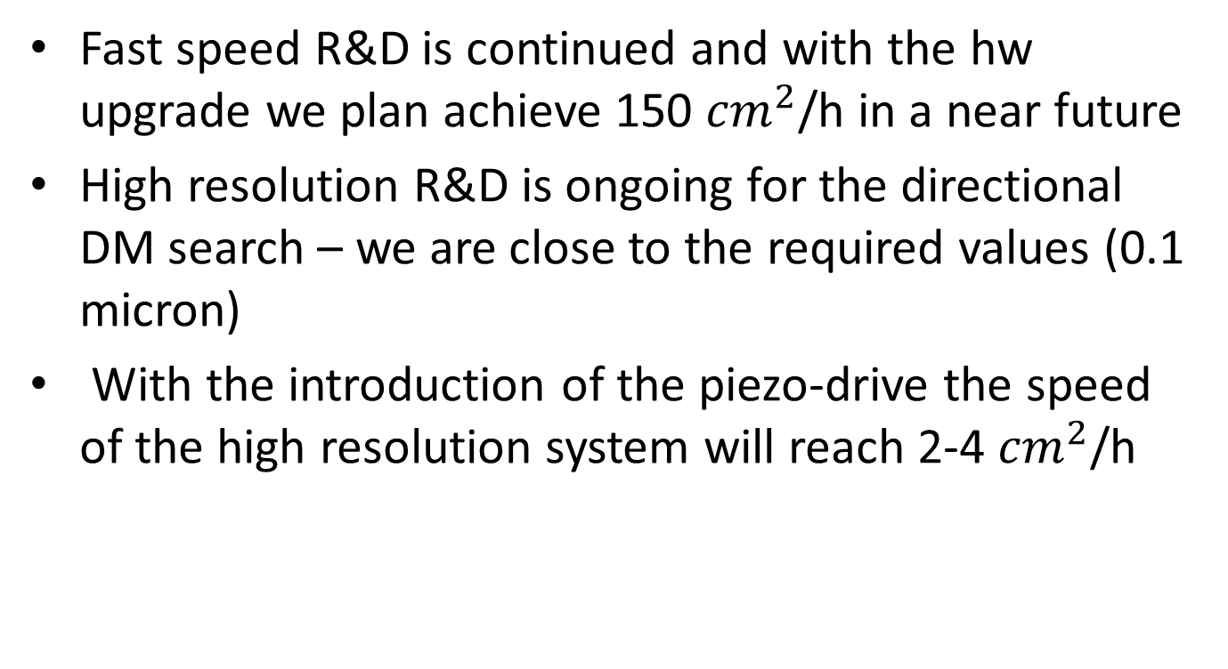
Outlook
Fast speed R&D is continued and with the hw upgrade we plan achieve 150 ${cm}^{2}$/h in a near future
High resolution R&D is ongoing for the directional DM search – we are close to the required values (0.1 micron)
With the introduction of the piezo-drive the speed of the high resolution system will reach 2-4 ${cm}^{2}$/h

